Slide 1
R for data Science

Slide 2
PIPE

Slide 3
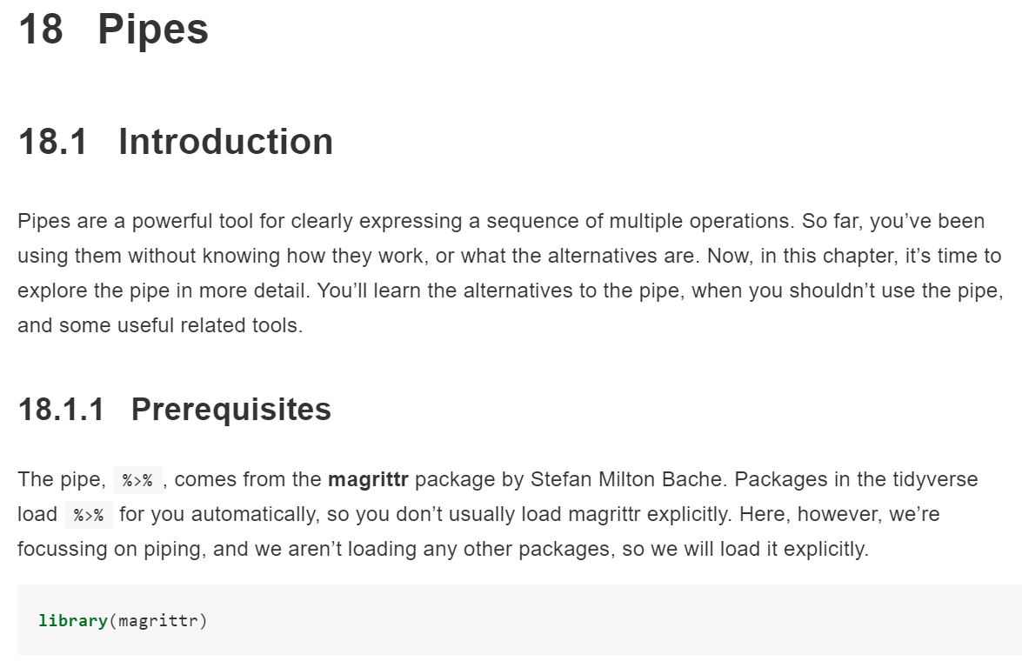
19.2 When should you write a function?

Slide 4
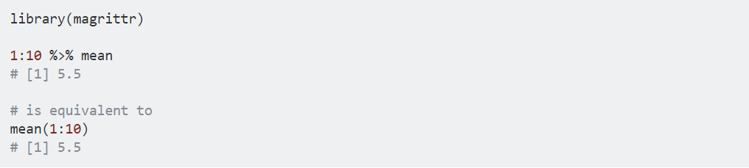
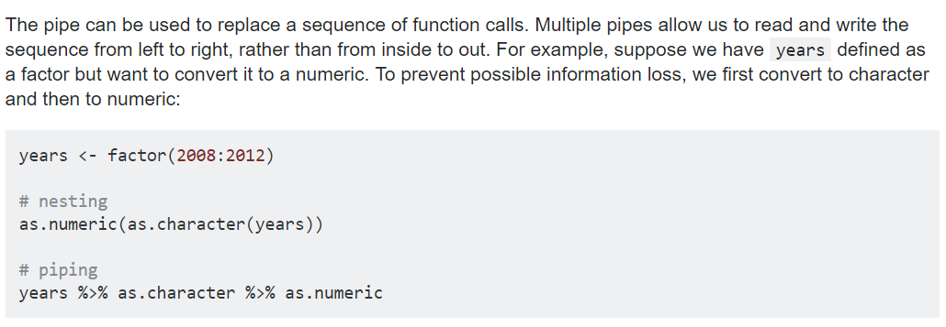

Slide 5
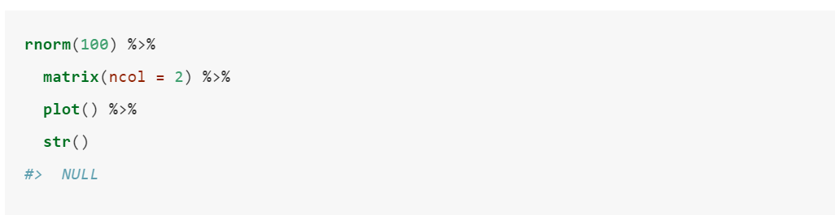
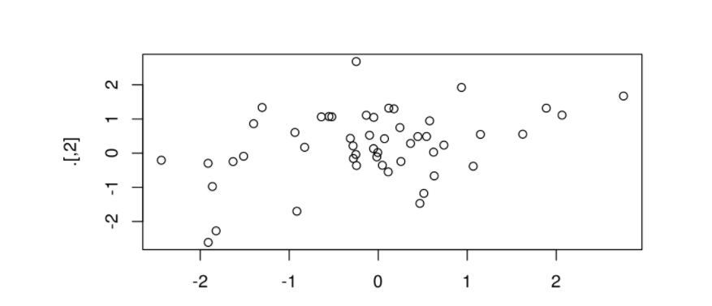

Slide 6
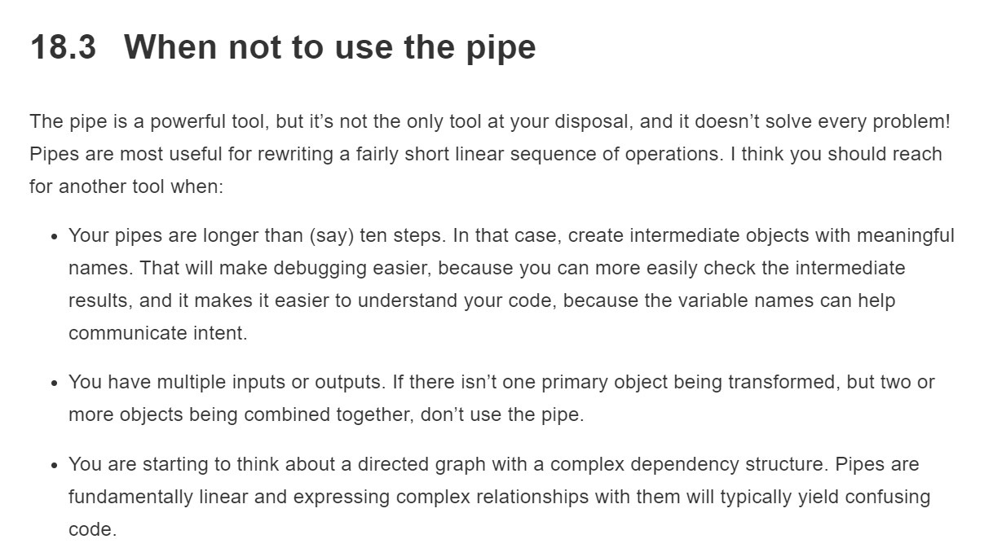

Slide 7
Functions

Slide 8
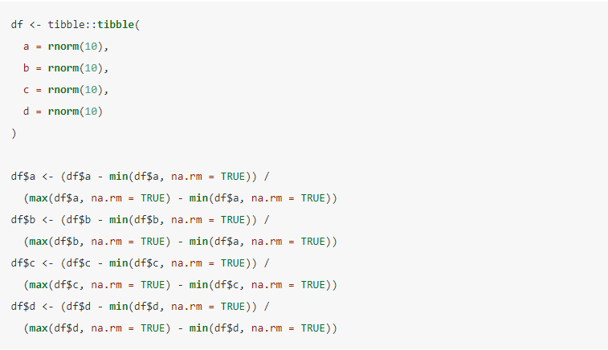
19.2 When should you write a function?
mistake 발생

Slide 9


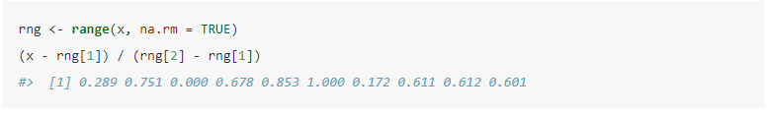
19.2 When should you write a function?
df$a 대신에 x를 사용
min max 대신 range 함수를 이용

Slide 10
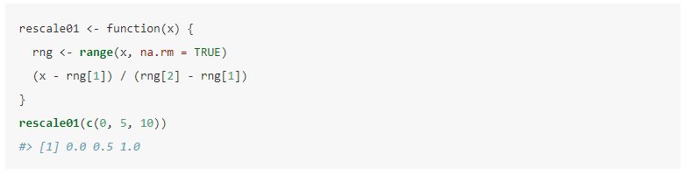
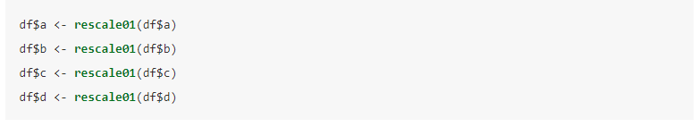
19.2 When should you write a function?
함수 작성

Slide 11
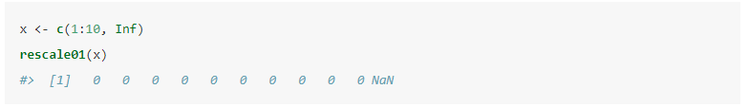
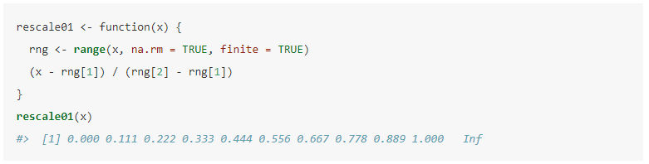
19.2 When should you write a function?
예외 처리

Slide 12
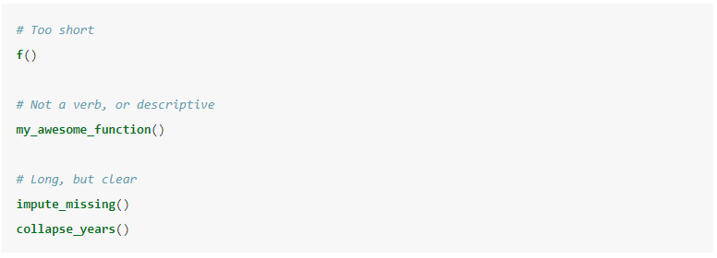
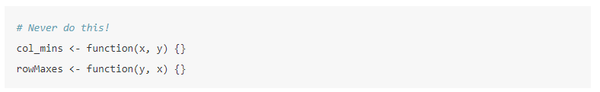
19.3 Functions are for humans and computers
띄어쓰기를 _ 사용하기
통일성 유지하기

Slide 13
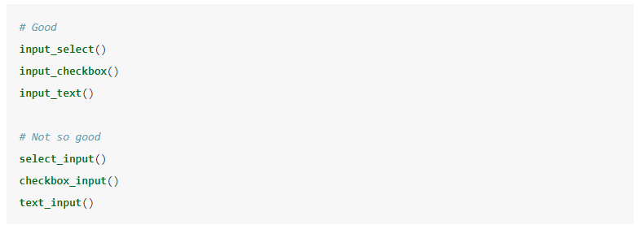
19.3 Functions are for humans and computers
공통 부분을 앞에 쓰기

Slide 14
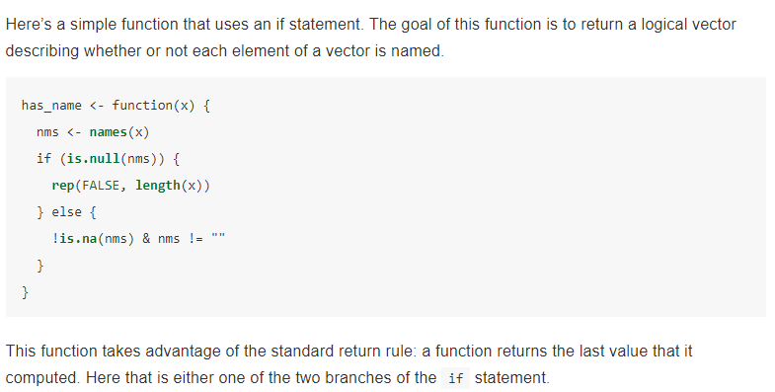
19.4 Conditional execution

Slide 15
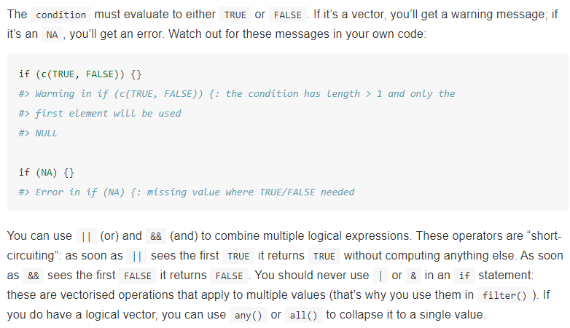
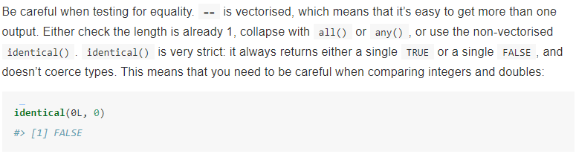

Slide 16
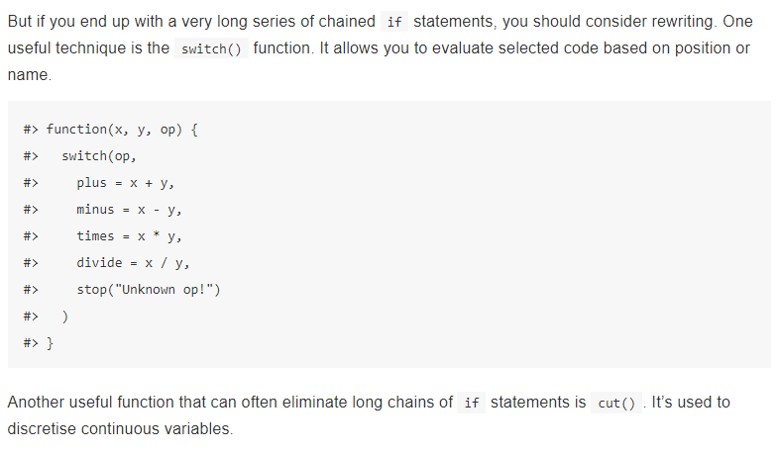
19.4 Conditional execution

Slide 17
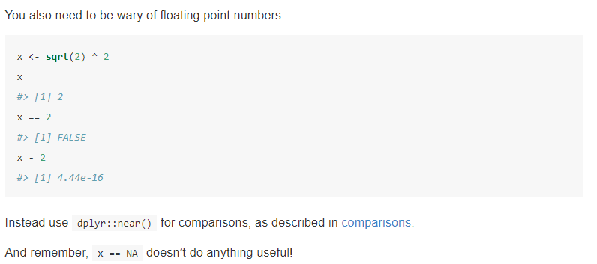
19.4 Conditional execution

Slide 18
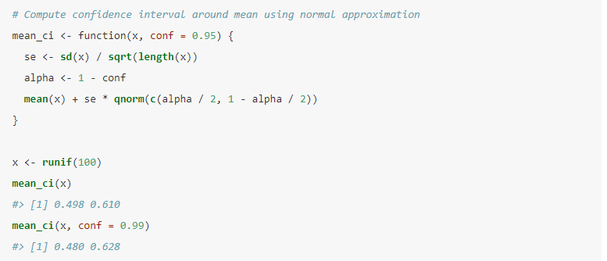
19.5 Function arguments

Slide 19
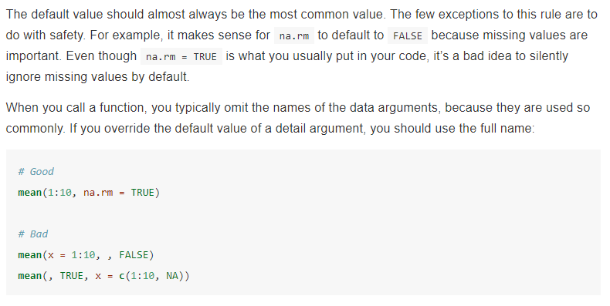
19.5 Function arguments

Slide 20
19.5 Function arguments

Slide 21
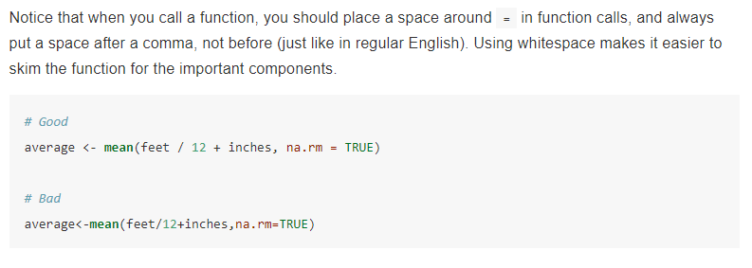
19.5 Function arguments

Slide 22
19.5 Function arguments

Slide 23
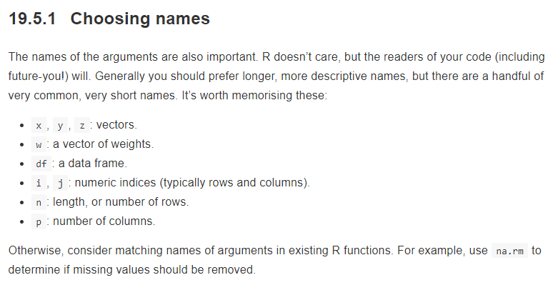
19.5 Function arguments

Slide 24
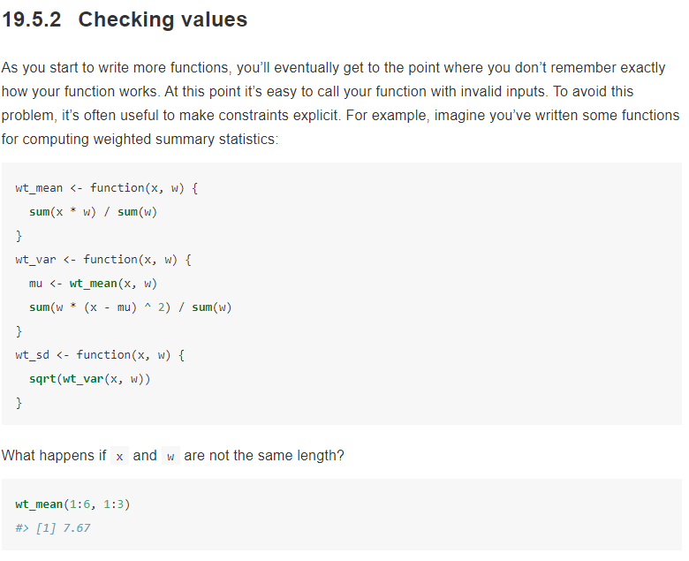

Slide 25
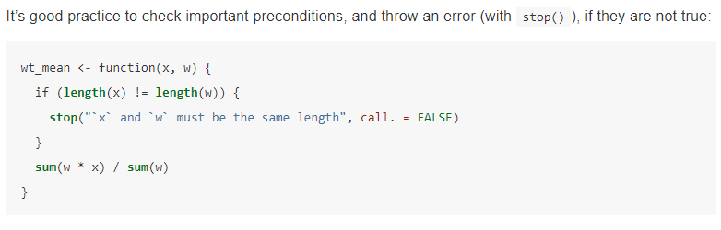
19.5 Function arguments

Slide 26
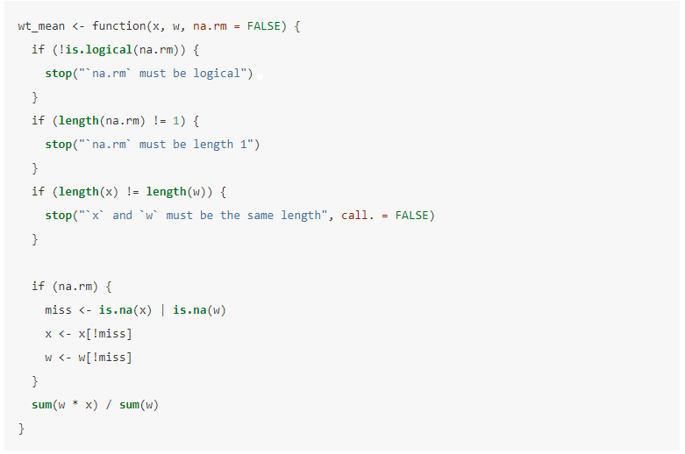
19.5 Function arguments

Slide 27
19.5 Function arguments

Slide 28
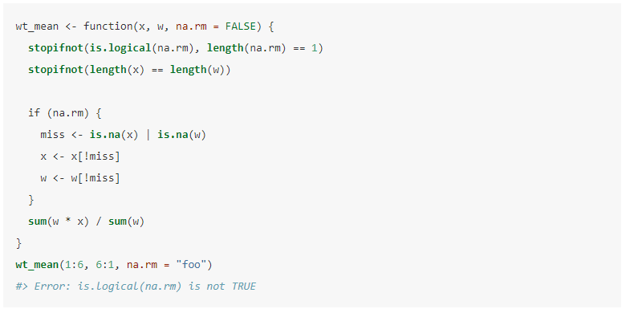
19.5 Function arguments

Slide 29
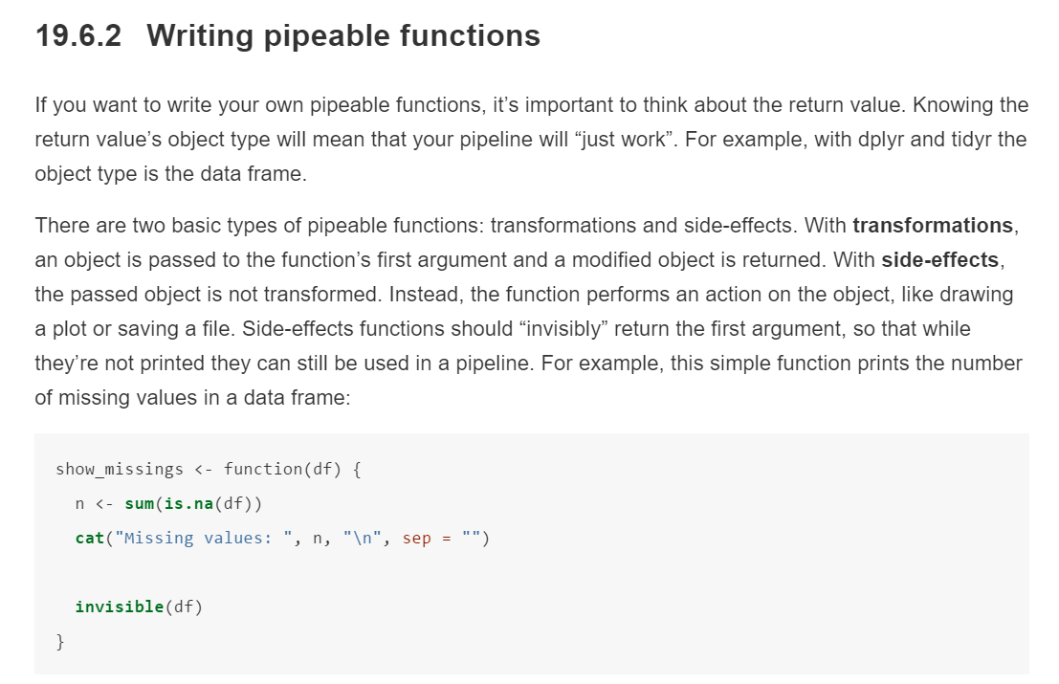

Slide 30
